Slide 1

FlowTrack: Intelligent Traffic Control
FlowTrack is an intelligent traffic control system designed to optimize traffic flow and enhance mobility in urban environments. This presentation will explore its features, functionalities, and the underlying technology that powers it.

Slide 2
A Smarter City
Real-time Monitoring
Violation Detection
FlowTrack uses traffic sensors and cameras to monitor real-time traffic conditions, providing valuable insights for optimizing traffic flow.
The system automatically detects traffic violations, such as red-light jumping and speeding, using camera footage and sensor data.

Slide 3
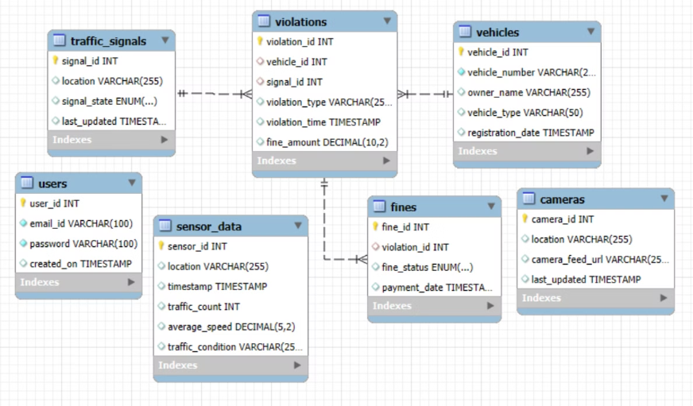
Database Diagram

Slide 4
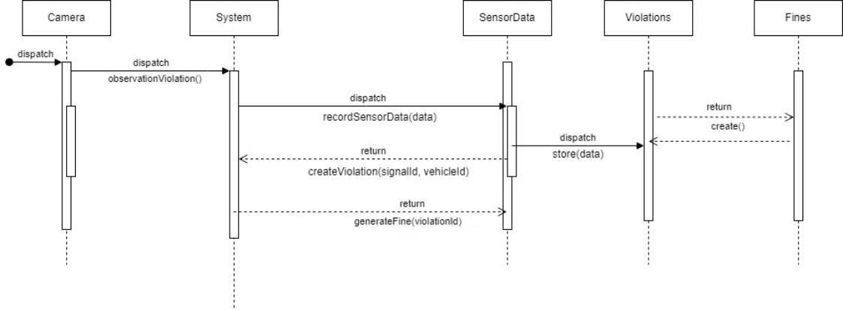
Sequence Diagram

Slide 5
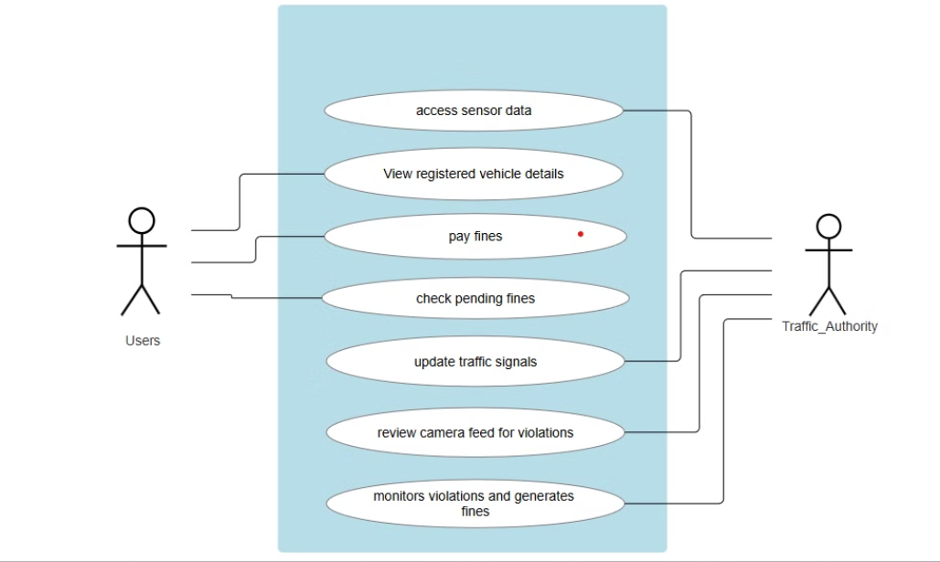
Use Case Diagram

Slide 6
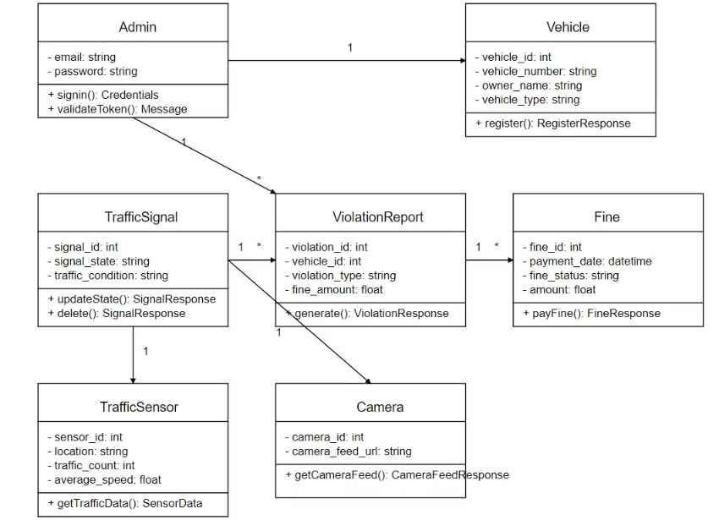
Class Diagram

Slide 7
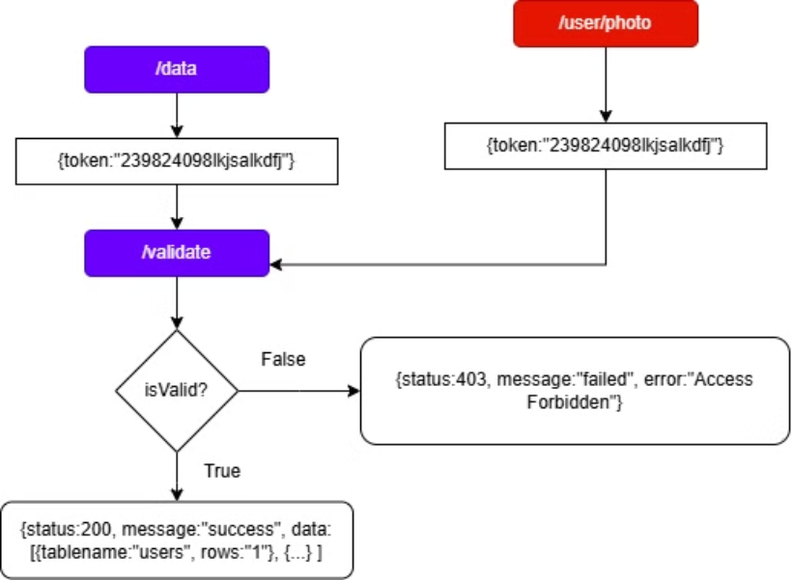
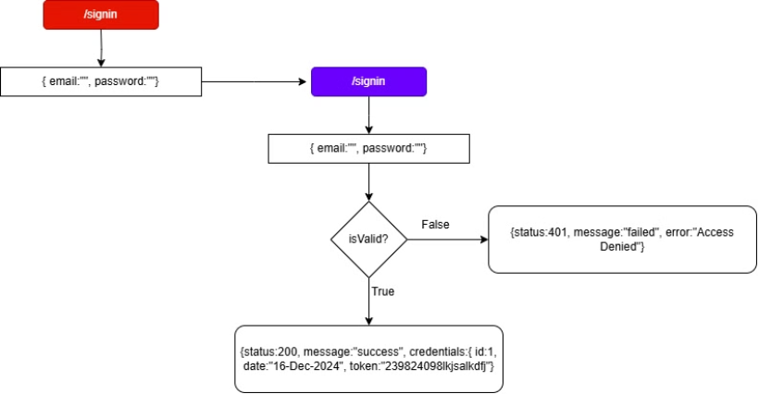
Flow Chart

Slide 8
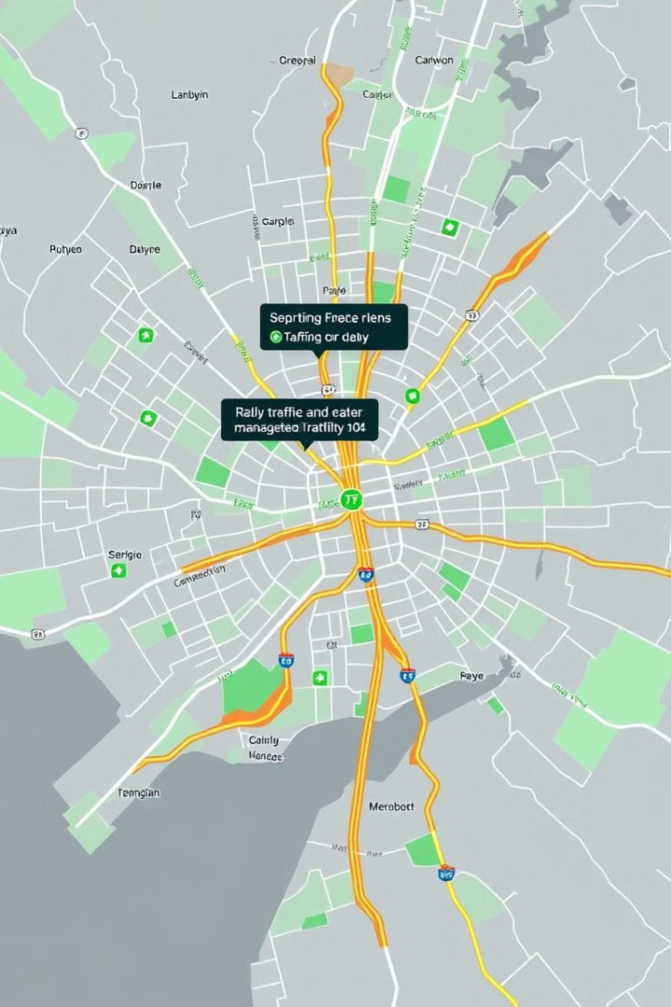
Efficient Traffic Management
1
Dynamic Signal Adjustment
2
Violation Reporting
The system generates detailed violation reports, including images, fines, and vehicle information, supporting efficient enforcement and accountability.
FlowTrack intelligently adjusts traffic signal timings based on real-time traffic flow, minimizing congestion and maximizing efficiency.

Slide 9




Database Architecture
MySQL
MongoDB
AWS S3
Vehicles, Traffic Signals, Violations, Fines, Traffic Sensor Logs
Camera footage details
Violation Images, Video Footage

Slide 10
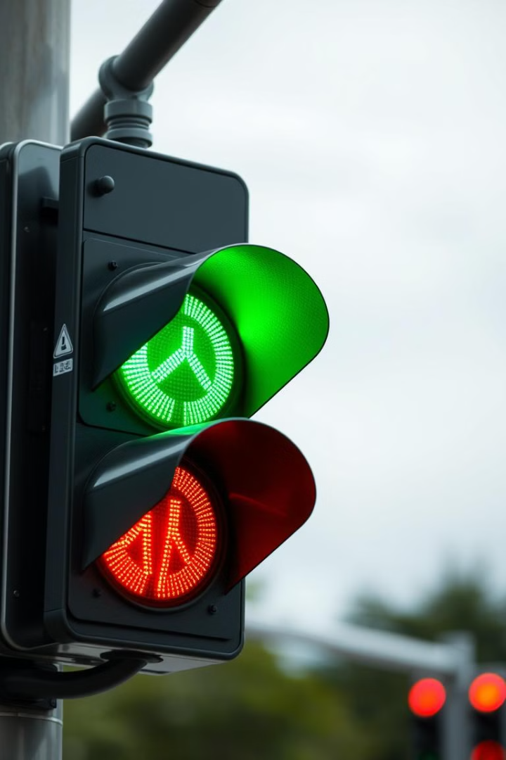
Traffic Signal Management
1
Initial State
The traffic signal defaults to red to ensure safety and regulate traffic flow.
2
Sensor Data Collection
Traffic sensors provide real-time data on traffic flow, such as vehicle density and average speed.
3
Signal Adjustment
FlowTrack dynamically adjusts traffic signal timings based on the collected sensor data, prioritizing traffic flow and minimizing congestion.

Slide 11
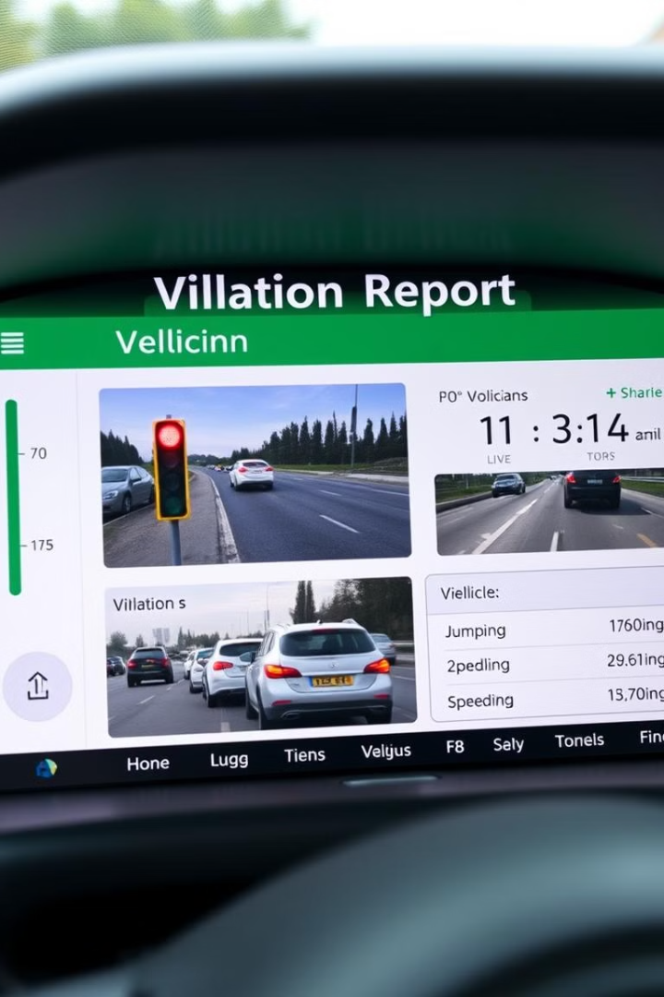



Violation Detection and Reporting
Camera Footage Analysis
FlowTrack analyzes camera footage in real-time to detect traffic violations.
Violation Confirmation
The system will use AI-powered algorithms to confirm the violation based on image recognition and traffic sensor data.
Violation Report Generation
A detailed violation report is generated, including images, time, location, and fine details.

Slide 12
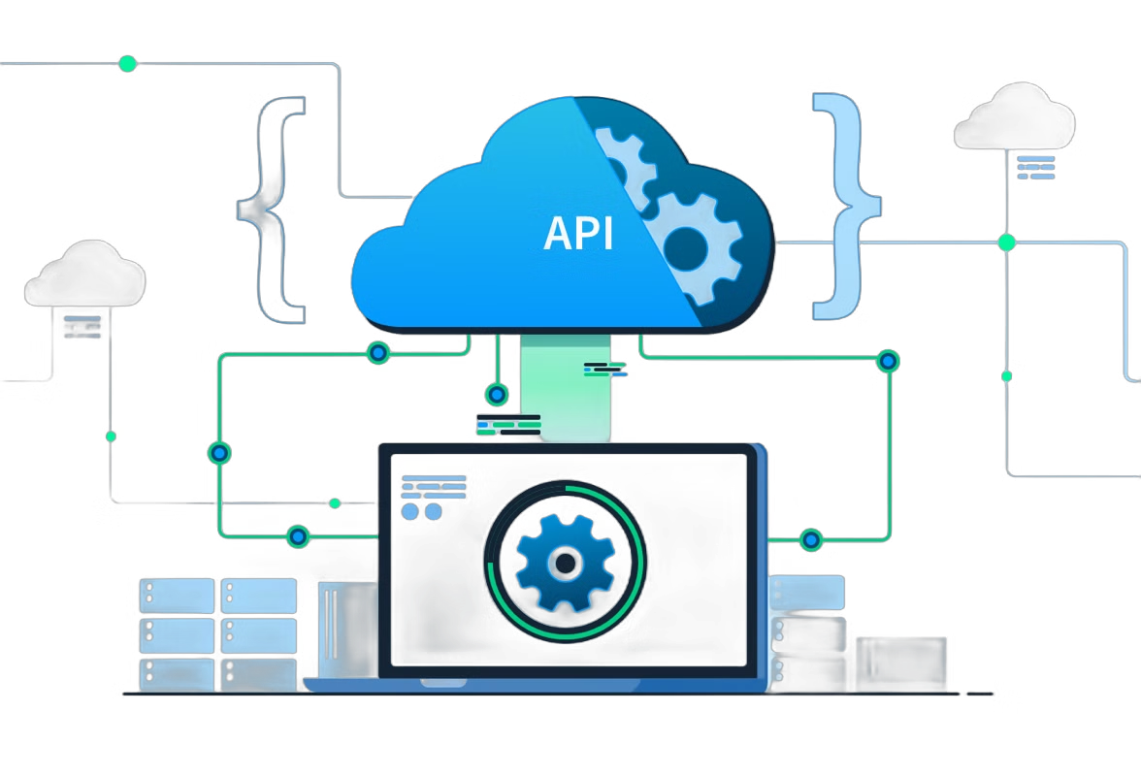
API Endpoints
1
2
Vehicle Registration
Traffic Signal Management
Users can register their vehicles, providing details like vehicle number, model, and owner information.
Authorities can control traffic signal timings, adjusting them based on real-time traffic conditions.
3
4
Violation Reporting
Traffic Monitoring
The system provides APIs for generating violation reports and accessing violation data.
APIs allow access to real-time traffic data, including sensor readings, traffic flow, and congestion levels.

Slide 13
Future Directions
Advanced AI Integration
1
Integrating advanced AI algorithms for more accurate violation detection and traffic flow optimization.
Real-time Traffic Prediction
2
Leveraging machine learning to predict traffic patterns and proactively adjust traffic signals to minimize congestion.
Smart Mobility Integration
3
Integrating with smart mobility solutions like ride-sharing platforms and autonomous vehicles to improve overall transportation efficiency.

Slide 14
Group Member
Use Case each person worked on
Anushka Ravindra Sandbhor
AWS S3 upload, admin authentication
Shourya Chourasia
Vehicle Registration Management, MongoDB Database management
Rani Uttam Kamble
Traffic Violation Detection and Reporting, Testing
Anusha Tikarya
Fine Payment Automation, MYSQL database management
Vaidehi Vithoba Pipare
Violation Report Generation, PPT

Slide 15
Our Team -
ANUSHKA SANDBHOR (HOST)
RANI KAMBLE (CO - HOST)
Thank you !
SHOURYA CHOURASIA
ANUSHA TIKARYA
VAIDEHI PIPARE

